Slide 1

Faculty of Computer and Information Sciences Ain shams University
Information Systems Department (2022-2023)

Slide 2

Real-Estate Smart Prediction System

Slide 3
Supervisor:
Dr. Sherine Rady

Slide 4
TA:
Dr. Amal Moustafa

Slide 5
Team members:
Abdelrahman Mohammed Ahmed.
Amany Adel Soliman.
Shehab Adel Abdelgleel.
Abeer Ahmed Sholkamy.
Osama Ahmed Ahmed.
Esraa Mohammed Abdelhamid.

Slide 6
Agenda:
Introduction.
Objective
Dataset
System Architecture.
Main Functionalities.
Extra Functionalities.
Algorithms.
Software Tools
Screenshots of the system
Demo
References.

Slide 7
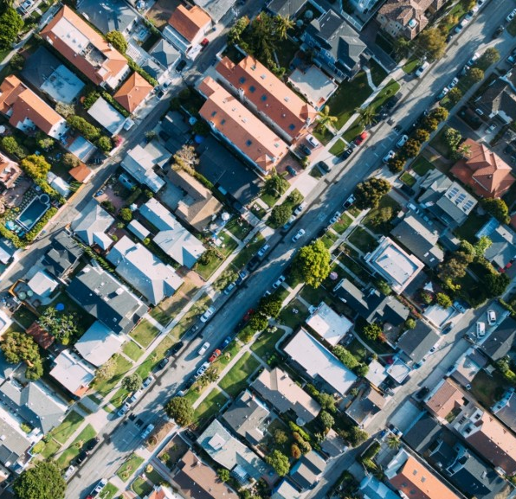
Introduction:
Real-Estate market in Egypt has always been challenging to deal with many features in the estate define it's values and our part is to let you know which one of them matters the most.

Slide 8

Objective:
Offering help in finding the estate you need in fastest time and easiest way.
Help you to sell your estate.
Predicting the price of a estate based on the giving features.
Prediction whether the estate appropriate for investment or not?

Slide 9

Dataset:
Egypt villas price depending on amenities and city locations 2022.

Slide 10
Attributes of dataset:
Type
Price
Bedrooms
Bathrooms
Area
Furnished
Compound
Payment_Option
Delivery_Date
Delivery_Term
City
Description
Private_Garden
Security
Balcony
Pets_Allowed
Covered_Parking
Maids_Room
Electricity_Meter
Natural_Gas
Landline
Pool
Central_heating
Built_in_Kitchen_Appliances
Elevator

Slide 11
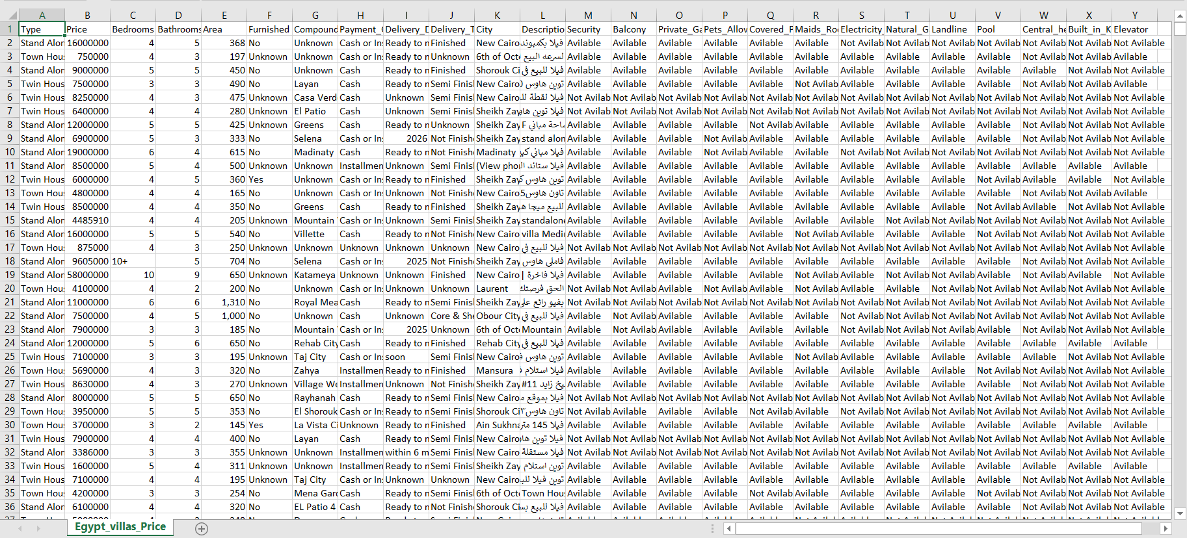
Project analysis slide 10
Dataset(Egypt_villas_price)

Slide 12
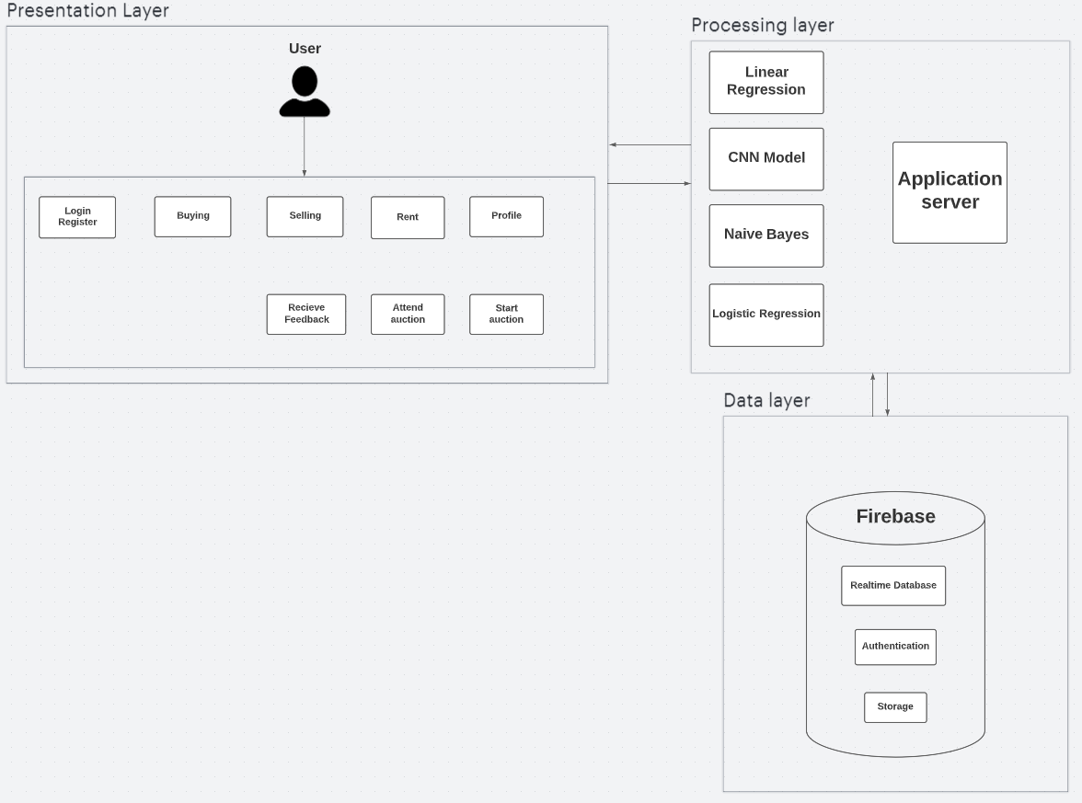
System Architecture

Slide 13
Main Functionalities
Register & log in.
Each user have a profile with public rate.
Each user can buy or sell.
User can either rent or offer his estate for rent.
Recommending estates that are nearby to the selected location.
Prediction for price by different features.
Algorithm to find the estate with the highest rate, lowest Price and largest space. Market risk price accuracy after 10 years(Bays rule):
(using some information about the estate, system can tell the user the percentage of risk over the next 10 years).
Predict the price range(clustering).

Slide 14
Main Functionalities (Cont.)
There will be part like auction:
Seller can add his item and choose date of auction’s starting.
Buyer can add this item to his wish list and get notification before starting.
There is screen with highest price and name of the owner of the highest price, screen update automatic when another buyer enter high price.
When auction end buyer and seller get message with info. about each others included phone number.
The higher auction price, the higher the risk.

Slide 15
Extra Functionalities
Filtering estates by regions ,rate and price.
Making a wish list of items.
Rating and reviewing system happens after the completion of the deal.
Previewing the offers and discounts in the top.
Show top 10 sales & top 10 sellers according to rating and people’s evaluation of them per week.

Slide 16

Algorithms

Slide 17

XGBoost Algorithm
To predict price
XGBoost is a popular algorithm for solving supervised learning problems, such as regression and classification.
XGBoost is a popular algorithm for solving supervised learning problems, such as regression and classification.

Slide 18
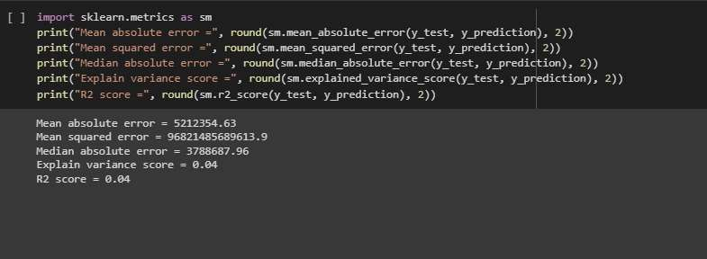
XGBoost Algorithm
Model with bad R2
R2 score = 0.04

Slide 19
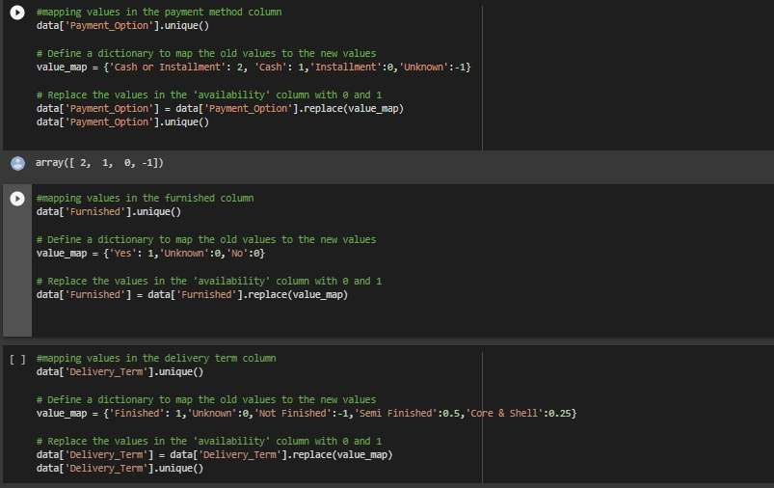
XGBoost Algorithm
Preprocessing
Encoding

Slide 20
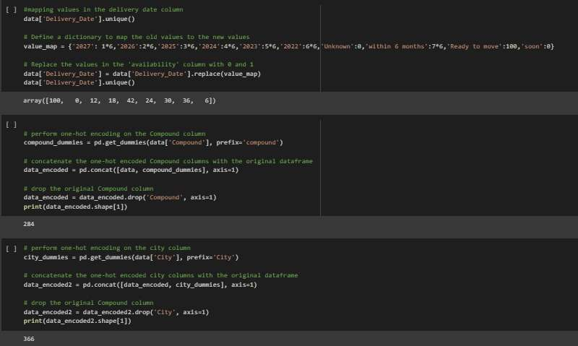
XGBoost Algorithm
Encoding

Slide 21
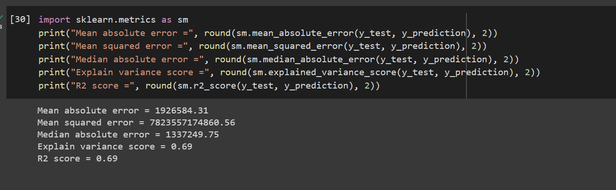
XGBoost Algorithm
The R2 score is updated = 0.69

Slide 22
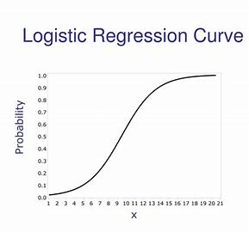
Logistic Regression:
Suggest estate for investment.
Logistic regression is a supervised learning algorithm used for classification problems, where the output is a binary variable.

Slide 23

Naive Bayes:
Classifier to classify to categories.
Naive Bayes is a probabilistic algorithm used for classification problems.
It is based on Bayes' theorem, which describes the relationship between the probability of a hypothesis given the data and the probability of the data given the hypothesis.

Slide 24
CNN Model:
Image classification (Building or not).
CNNs are a type of neural network commonly used for image recognition and classification tasks.
They are designed to take advantage of the spatial structure of image data.

Slide 25




Software Tools:
C# & .Net framework
To manage back-end.
Python in Machine Learning
HTML , CSS & JS
React to design
front-end.
Storage

Slide 26
Screenshots of the system

Slide 27
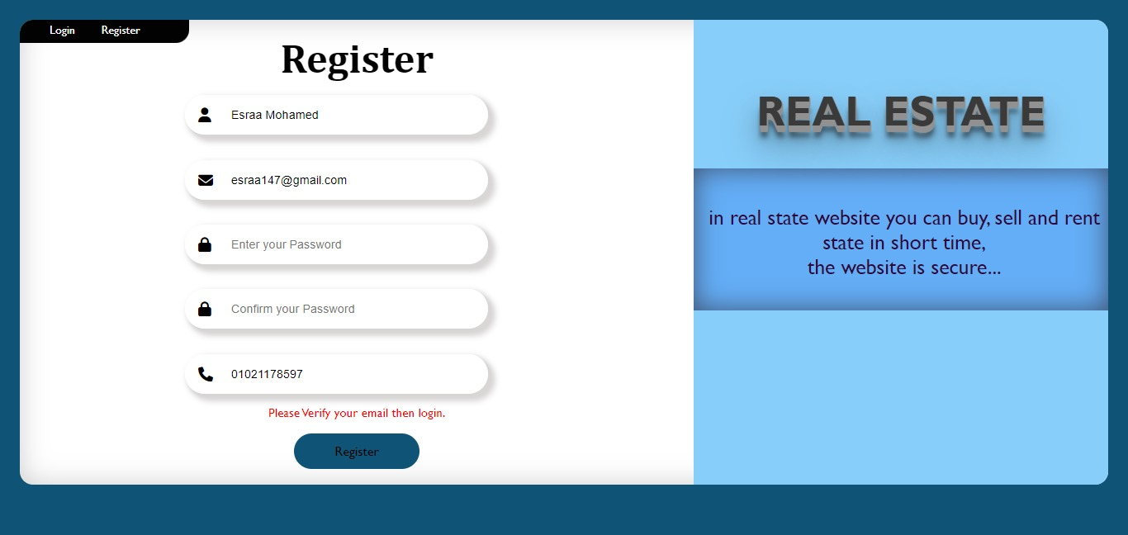

Slide 28
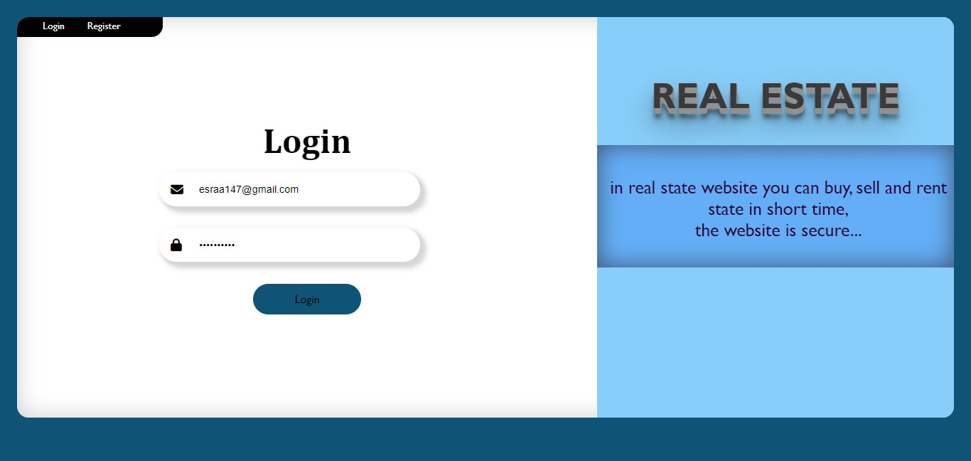

Slide 29
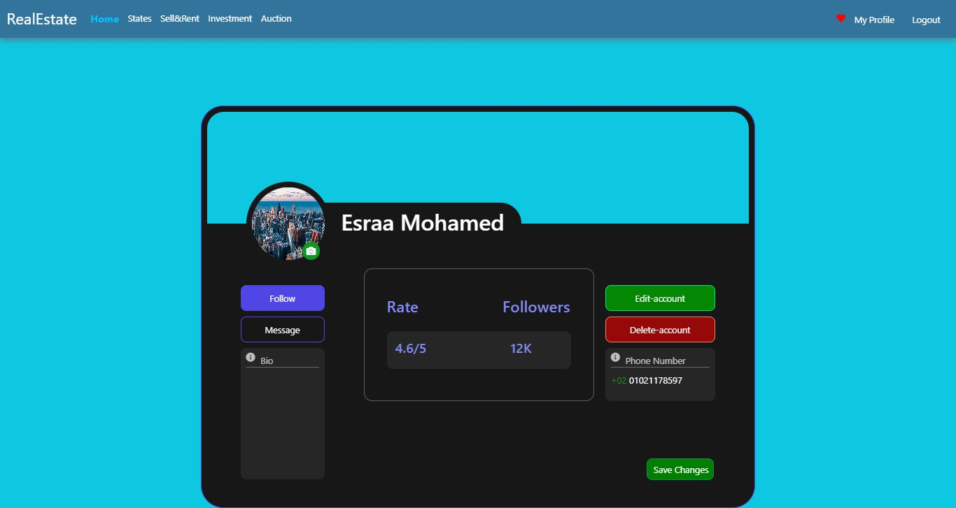

Slide 30


Slide 31
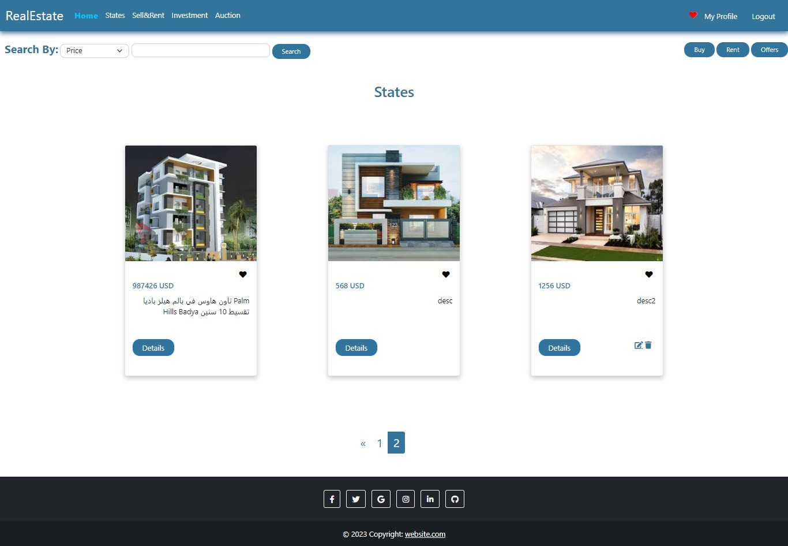

Slide 32
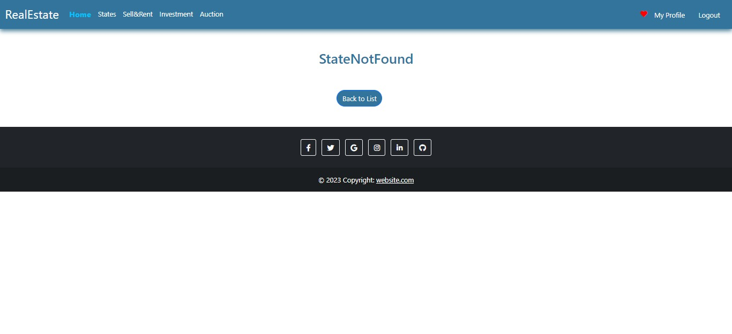

Slide 33
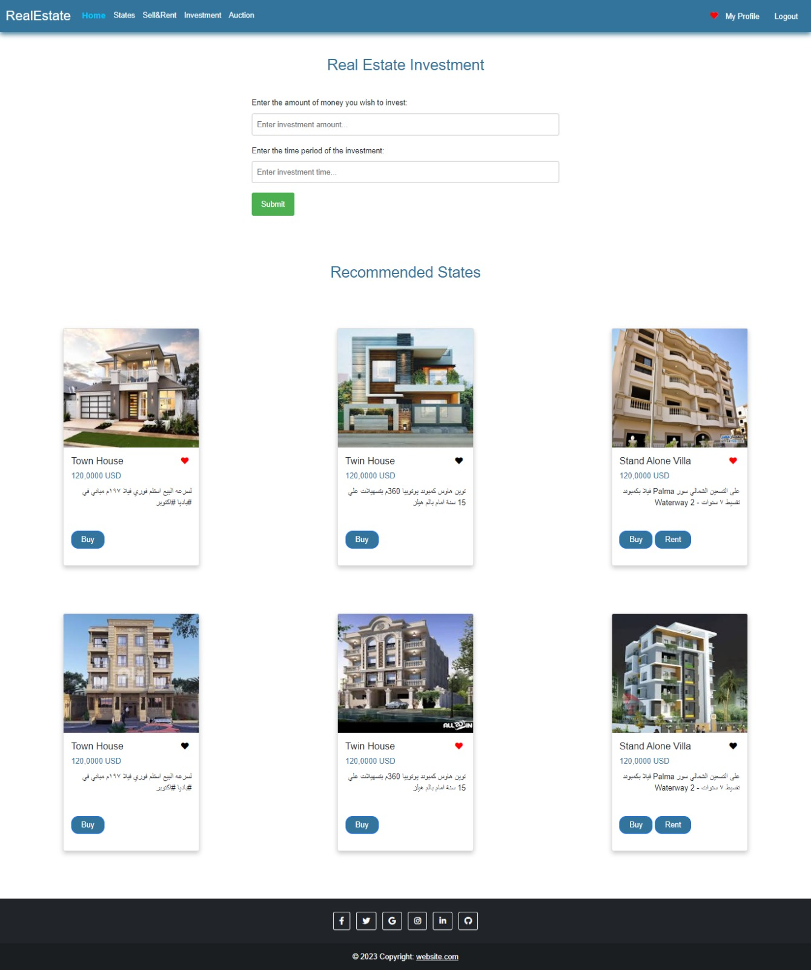

Slide 34
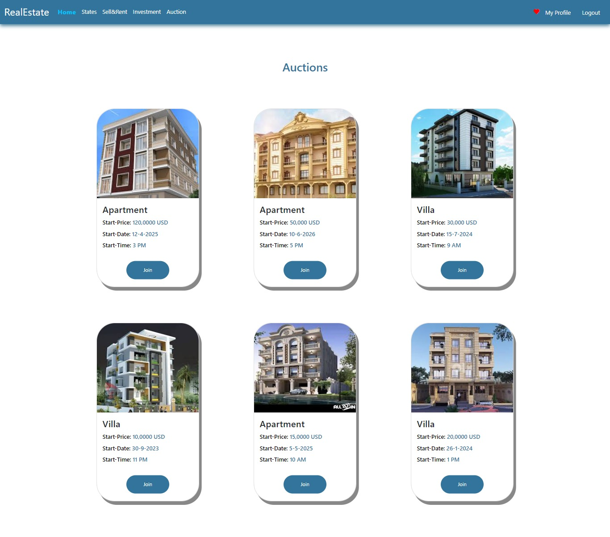

Slide 35
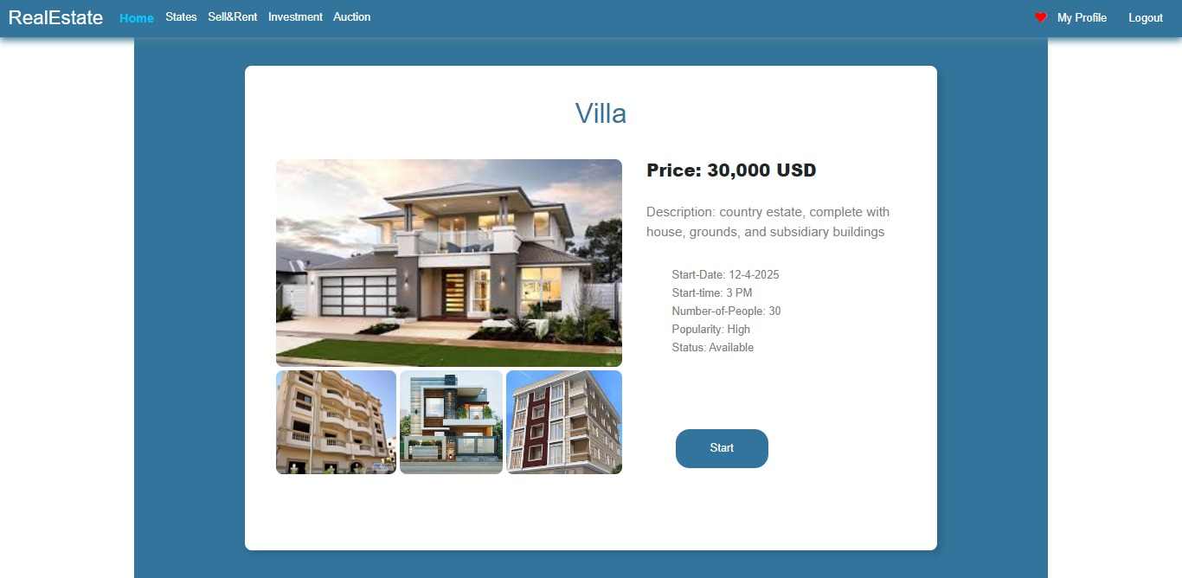

Slide 36
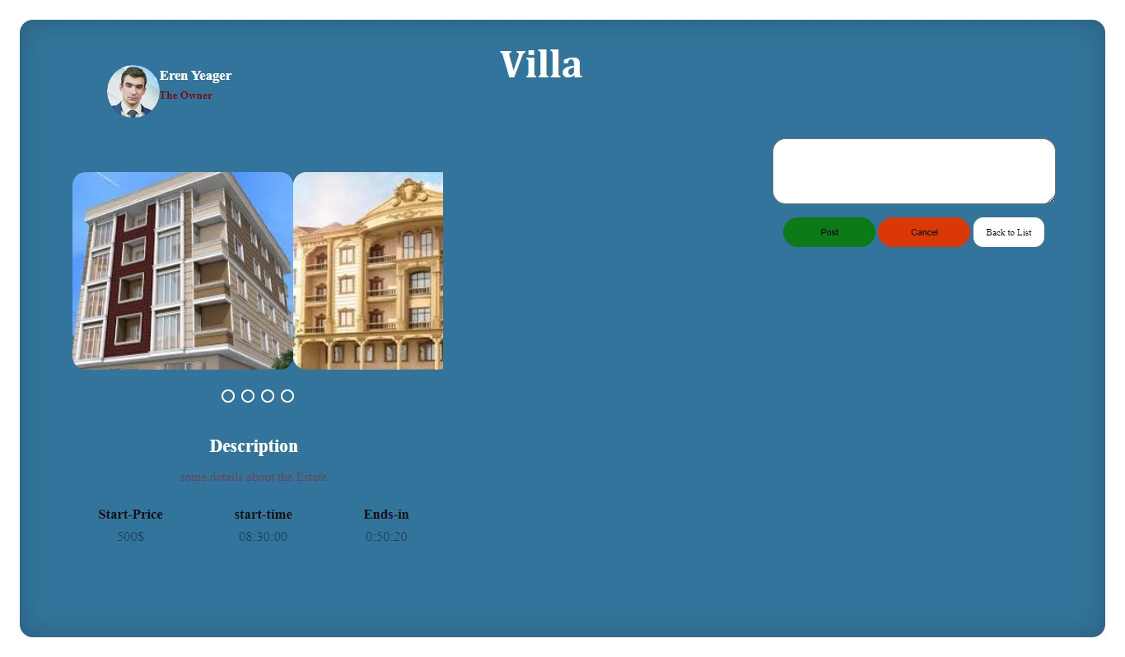

Slide 37
Demo

Slide 38
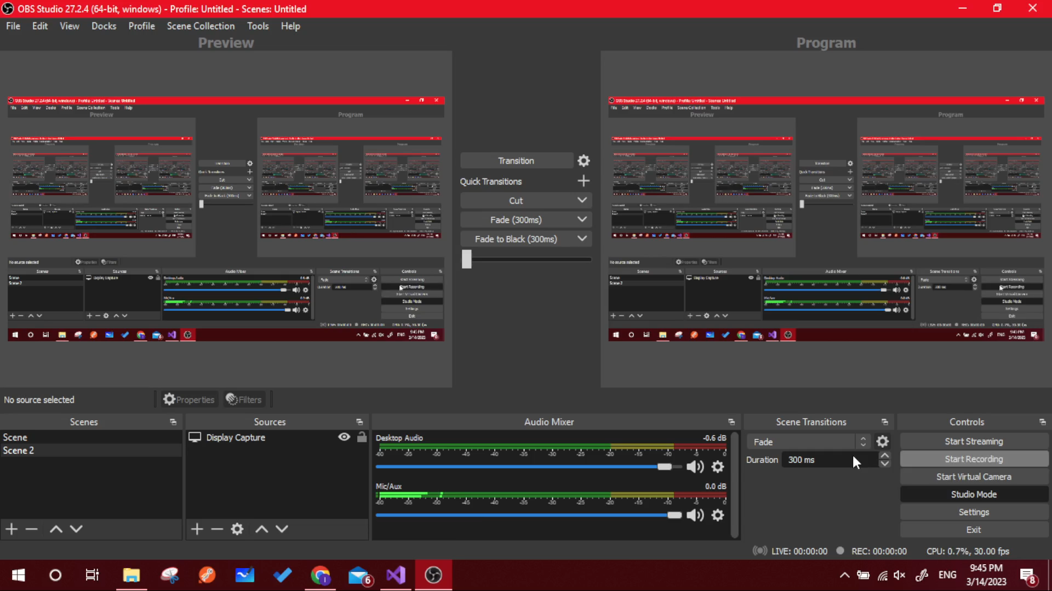

Slide 39
References:
https://www.kaggle.com/datasets/mohammedaltet/egypt-villas-with-amenities-price (Dataset)
https://lucid.app/lucidspark/ddd2a66a-57b4-480a-9abc-1a6071e1e10a/edit?invitationId=inv_fc030dbc-92c6-4be9-a110-0d5a346183a8# (System architecture)
https://github.com/Eng-Esraa7/DataScienceProject (CNN Model)

Slide 40
Thank you

